Slide 1

BeeSmart
- The Spell Bee Game -
Sprint: Programming the Web
Team:
Ashmitha R
Rashika S
Rachana S

Slide 2
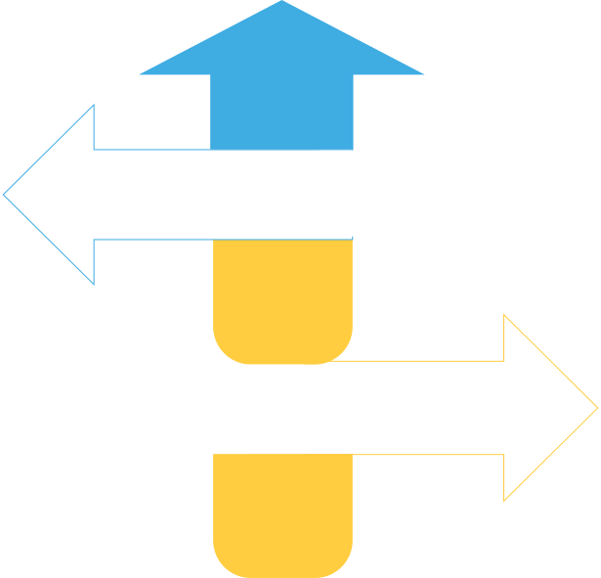
PROJECT SCOPE
Team
  Shared roles:
    Ashmitha: HTML structure and page design (Name, Avatar, Accent screens)
    Rashika: CSS styling, layout, and theme consistency
    Rachana: JavaScript logic, Fetch API integration and Wireshark
APIs Used
  Random Word API → fetches a random English word
  Dictionary API → gives meaning & synonyms
  Together they make each round educational & interactive
Deliverables
Project Expectations
Goals
✓ Hosted webpage link: https://69016ce0344624ed6cab4653--dainty-vacherin-c64991.netlify.app/
✓ Source code (index.html, style.css, script.js).
✓ Wireshark captures + 2–3 page analysis report
  Build an interactive API-based webpage
  Implement DOM manipulation and event listeners
  Analyze API communication using Wireshark
Project Deliverables
Tools & Technologies
Constraints
  HTML, CSS, JavaScript (Fetch API + Async/Await)
  Wireshark – to trace TCP/TLS packets
  Netlify– for online hosting
  Use only open/free APIs
  Page must show clear DOM updates & interactivity
  Hosted version must load without any dependencies

Slide 3
PROJECT SCOPE & DELIVERABLES
Phase
Scope
Deliverables
Phase 1: Design & Setup
  Selected Random Word API & Dictionary API
  Designed flow: Name → Avatar → Accent → Level → Game → Game Over
  Created HTML structure with multiple <section> screens
  Added <meta> tags for responsive design
  HTML wireframe
  Basic CSS theme (black-yellow bee theme)
  Page layout centered using .container class
Phase 2: Development & Integration
  Used fetch() + async/await for API calls
  Added functions: getWord() & getMeaning()
  Implemented interactivity via buttons, avatars, flags, and levels
  Used built-in(inside the js) SpeechSynthesis to pronounce words in the chosen accent
  Dynamic DOM updates for score, timer, and meanings
  Working prototype
  Updated DOM with API results
  Buttons using .primary and .secondary classes for styling

Slide 4
PROJECT SCOPE & DELIVERABLES
Phase
Scope
Deliverables
  Captured Wireshark packets while fetching words
  Analyzed DNS resolution, TCP/TLS handshakes, and HTTP GET requests
  Compared latency on Wi-Fi vs mobile hotspot
  Hosted the final site online via Netlify
Phase 3: Testing, Analysis & Hosting
  Wireshark capture (.pcapng or screenshots)
  Hosted webpage link
  2–3 page report with screenshots and findings

